Slide 1
Computational Photography- Final Project
Anirudha Ramesh (aramesh3)

Slide 2
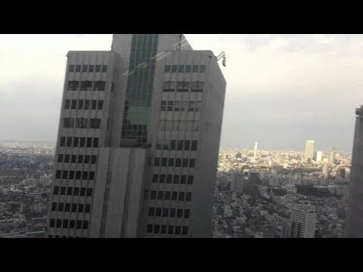

Motivation
Notes:
The world around is always moving. We are not always cognizant of it, but if we look close enough, everything is moving and objects are almost always subject to some forces. A lot of the movement happens in the form of vibrations, which are we can’t always pick up or take apart with just our eyes.
But analysing and understanding how objects vibrate can tell a great deal about their material properties, how they would likely move and so on. In this project, using
only video and no prior information on its structure, material etc., we wish to understand and extract information on how objects likely move.

Slide 3
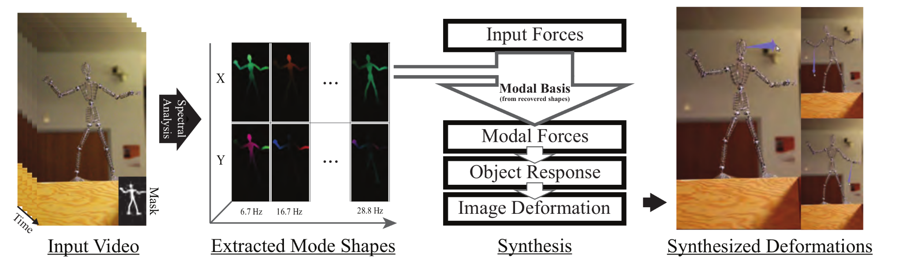
Introduction
Reference : http://www.interactivedynamicvideo.com/ISMB_Davis_2015.pdf
Notes:
If we have knowledge about the degrees of freedom of an object, and information about the dynamics of an object, we can predict how it will deform on the application of forces. However, in the real world, it’s very hard to always have prior knowledge about how arbitrary objects move and deform on application of forces. This would however be very useful in various scenarios. Be it better understanding how bridges respond to stress, or just animate arbitrary objects, which opens up endless possibilities in content generation, filming, augmented reality experiences etc.
While we might not have all the information above, we can get video of the object under forces very easily. If we can extract the ’motion basis’ of an object, we can subject it to other arbitrary forces, and get an approximate response of the object to the same. This can help us discover plausible manipulations of the object, and how the object will deform on the application of forces (assuming no structural damage).
Our project is based on Abe Davis’ paper from 2015, Interactive Dynamic Video, http://www.interactivedynamicvideo.com/

Slide 4
Related topics
Theory of Vibrations
Physically-based Animation
Observing Vibration Modes and Motion Magnification
Notes:
Our work combines, takes inspiration and builds on growth of a few different directions.
The first is the work on the theory of vibrations, and how vibrations, forces, and object properties combine.
The second relates to physically-based animation, which use modal analysis to reduce the degrees of freedom but often assume some geometric knowledge,
Motion Magnification, Extracting of Vibration modes and how we bring these two together is another important part of our work. Vibration modes are usually obtained with actual accelerometers and other sensors on our objects of interest. Using only video however, we can do so by magnifying motions that exist in it.

Slide 5
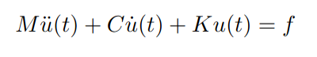
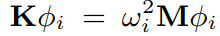
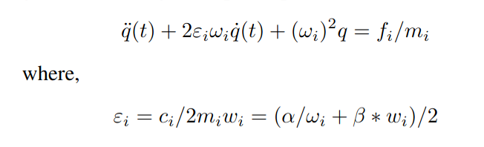
Theory on Modal Analysis
1)
The matrices M, C, and K represent mass, damping, and stiffness relationships between an object’s degrees of freedom, and f is the force it relates them to.
u(t) -> position, u’(t) -> speed, u’’(t) -> acceleration
2)
3)
Notes:
In order to understand and simulate the effect of forces on our objects of interest we must relate local object motion, forces, and frequencies of motion we can observe. We can do some by considering the spring equation shown above.
The eigenmodes of this system are the orthogonal solutions to the generalized eigenvalue problem given by eq2
Upon making some further simplifying assumptions and solving further we get the relation relating the quantities we wanted in eq3

Slide 6
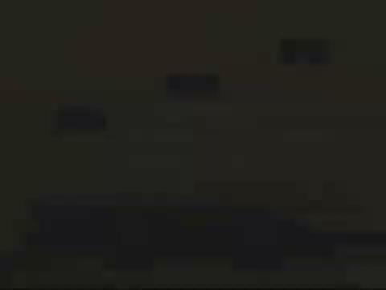
Through our Algorithm by Example
Tower 0 -> Moves very little
Tower 1 -> Moves more
Tower 2 -> Moves a lot
Example picked because it demonstrates the effectiveness and correctness of our extraction, and we know what to anticipate in our simulations.

Slide 7
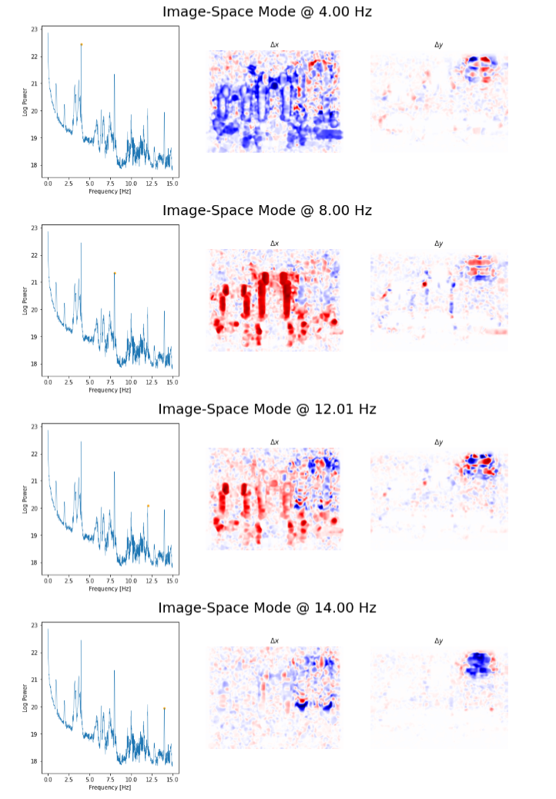
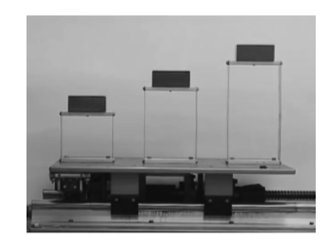
Algorithm
Extracting Candidate Modes and Mode Selection
Blue -> negative
Red -> Positive

Slide 8
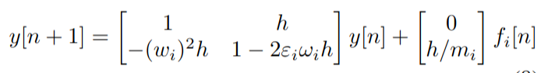
Algorithm
2) Simulate, and update position of each pixel

Slide 9
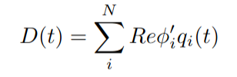
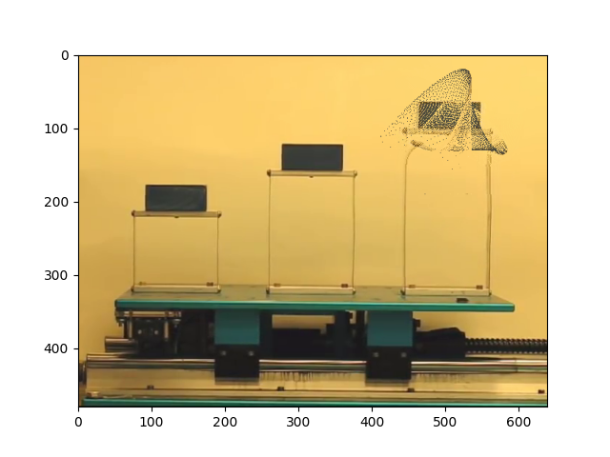
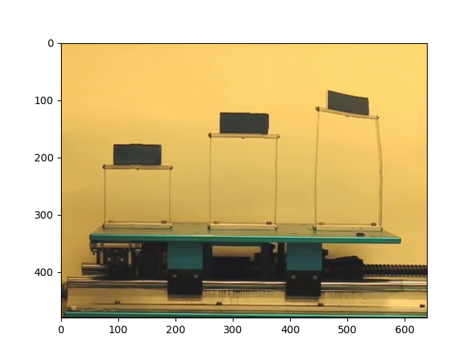
Algorithm
3) Render : Project Modal Displacements into pixel-level displacements
Smoothening

Slide 10
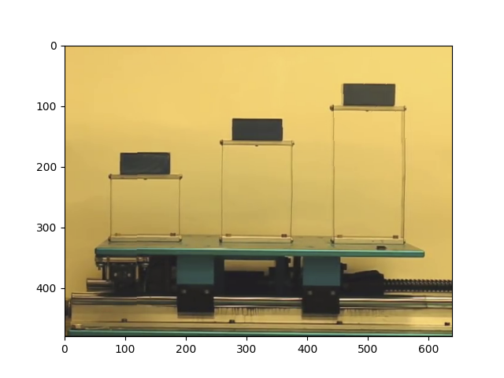
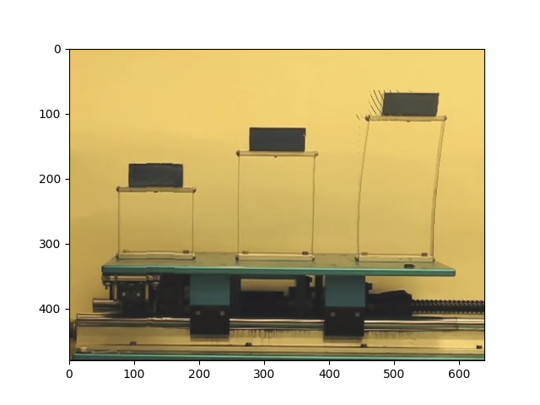
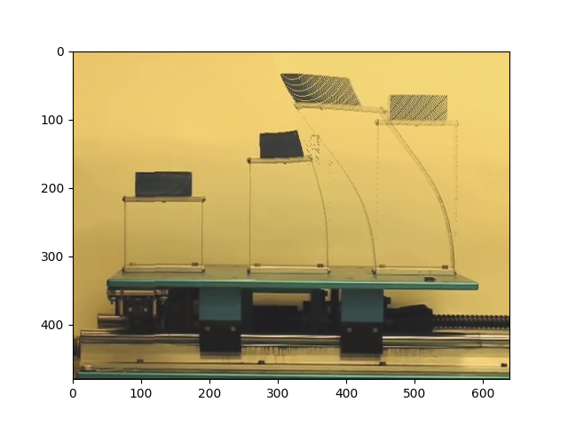
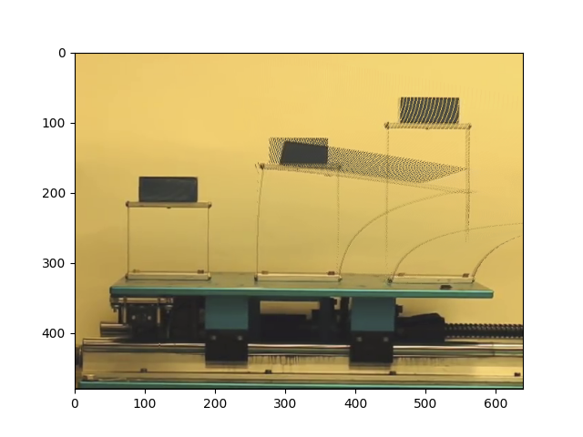
Results
Example one - variation across time-step. Reduced smoothing to show displacements more clearly.

Slide 11
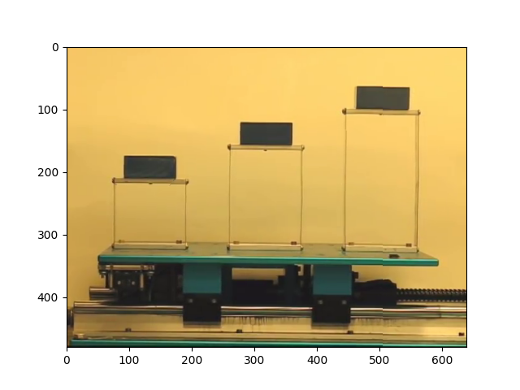
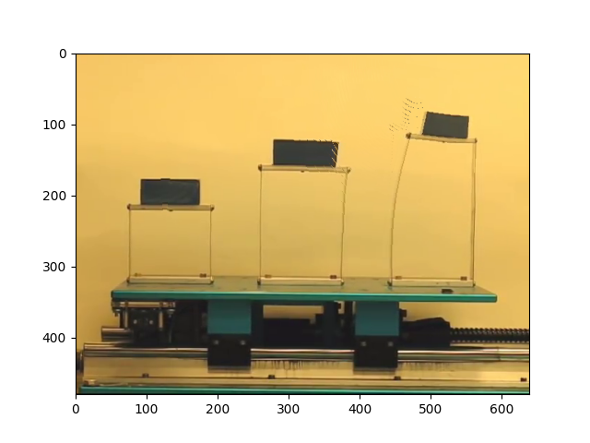
Results
Variation across objects
Force applied on tower-0 (minimal motion corresponds to what we saw in the video)
Same force applied on tower-2

Slide 12
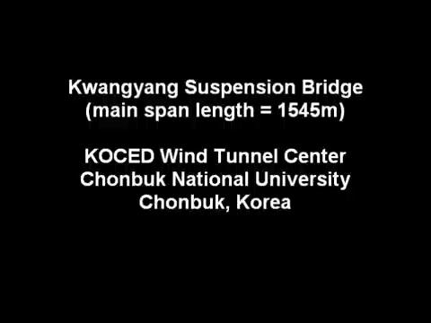
Results
Variation wrt to changing forces, and locations on the same object.

Slide 13
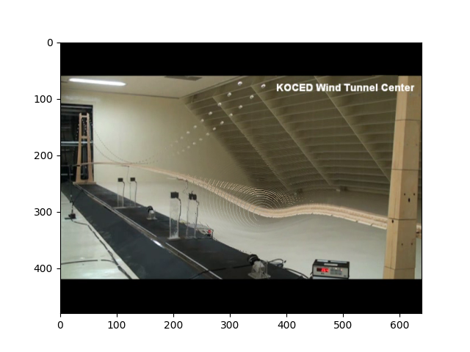
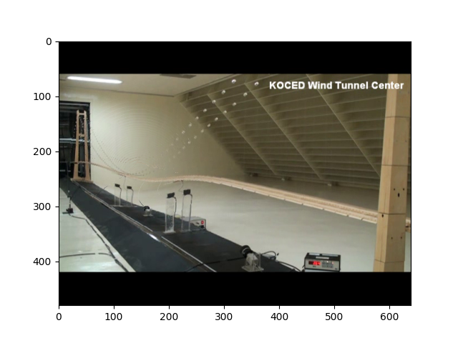


Results
Variation wrt to changing forces, and locations on the same object.
 | Location-1 | Location-2
Force f
Force f/10

Slide 14
Potential Improvements
Object/Edge Aware Filtering instead of Gaussian
Can improve by tying in in-painting as well using newer diffusion models/GANs which we can train in condition with our produced displacement maps, and train in a self supervised manner since we have entire videos of these situations (i.e, future frames).

Slide 15
Key References
http://www.interactivedynamicvideo.com/ISMB_Davis_2015.pdf
http://www.abedavis.com/thesis.pdf
https://github.com/berthyf96/visvib-tomography

